Slide 1

Rights Re-Write!
Re-writing the Bill of Rights

Slide 2
Just to review:
What is a Constitution? What is the purpose of the United States Constitution?

Slide 3
The United States Constitution:
Sets up the government
Defines powers and limits of the government
Lists some of the rights of the people
The social contract created between the government and the people in the U.S. Constitution is what makes us a Constitutional Government.
What are our rights as citizens of the United States according to the Constitution? Where do we find these rights?
Notes:
Ask students what “social contract” means (review of Locke PowerPoint – the agreement between the people and the government: the people agree to live under and obey the government, the people give the power to make and enforce laws, and the government gives protection to the people in return.

Slide 4
Parts of the US Constitution
PREAMBLE
SEVEN ARTICLES
AMENDMENTS (27)

Slide 5
Who does the Constitution protect us from?
Government

Slide 6
Finish the sentence…
A RIGHT IS…
What are some of the words or ideas you think of right away?

Slide 7
Key Words and Ideas
Something that cannot be taken away
Freedom
Liberty
Claim
Entitlement

Slide 8
A right is
“A justified claim or entitlement, or the freedom to do something” (Encarta Dictionary)
“Something to which one has a just claim” (Merriam-Webster Dictionary)
How would you define it?

Slide 9
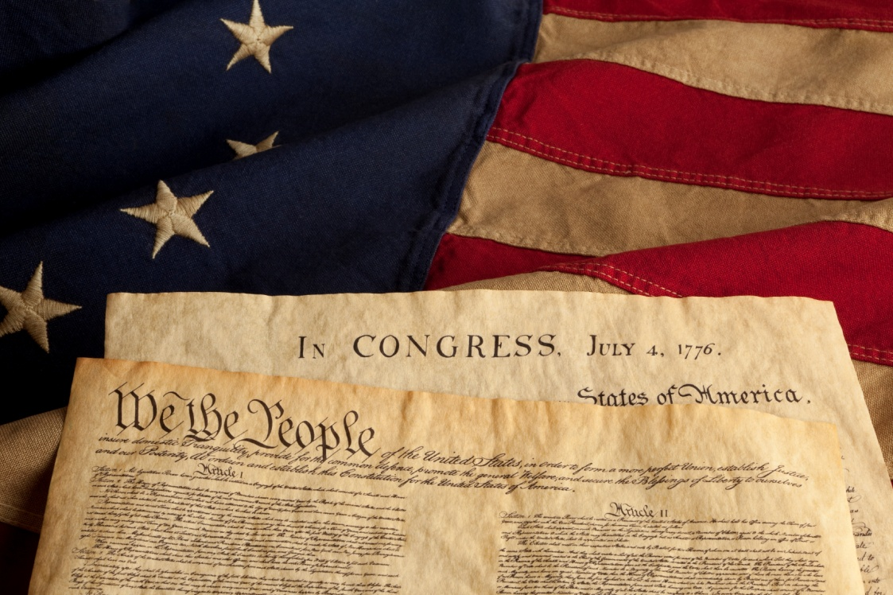
Where do we find our rights?
In the United States Constitution
&
The Florida Constitution

Slide 10
Parts of the US Constitution
PREAMBLE
SEVEN ARTICLES
AMENDMENTS (27)
  This also includes the Bill of Rights
What is the Bill of Rights?

Slide 11

The Bill of Rights
First ten amendments to the US Constitution

Slide 12


Let’s look at the first five rights in the Bill of Rights:
Amendment I: Freedom of religion, speech, assembly, press, and to petition the government
Amendment II: Right to bear arms
Amendment III: No quartering of solider in time of peace
Amendment IV: Freedom from unreasonable searches or seizures (without a warrant or probable cause)
Amendment V: Freedom from double jeopardy, from self-incrimination, right to due process, and eminent domain

Slide 13
Amendment I
Congress shall make no law respecting an establishment of religion, or prohibiting the free exercise thereof; or abridging the freedom of speech, or of the press; or the right of the people peaceably to assemble, and to petition the Government for a redress of grievances.

Slide 14
Amendment I (First Amendment)
Religion
Speech
Press
Peaceful assembly
Petition the Government
Remember the Fab 5?

Slide 15
Amendment II – (Second Amendment)
A well regulated Militia, being necessary to the security of a free State, the right of the people to keep and bear Arms, shall not be infringed.

Slide 16
The right of the people to keep and bear Arms
Arms: weapons, firearms
What limits should there be on the right to bear arms?

Slide 17
Amendment III (Third Amendment)
No Soldier shall, in time of peace be quartered in any house, without the consent of the Owner, nor in time of war, but in a manner to be prescribed by law.
Quartered: living or sleeping accommodations provided for somebody such as military personnel

Slide 18
Amendment IV (Fourth Amendment)
The right of the people to be secure in their persons, houses, papers, and effects, against unreasonable searches and seizures, shall not be violated, and no Warrants shall issue, but upon probable cause, supported by Oath or affirmation, and particularly describing the place to be searched, and the persons or things to be seized.

Slide 19


Right of the people to be secure
against unreasonable searches
and seizures
Search: To go or look through carefully to find something
Seizure: The taking of a person, an item, or property

Slide 20


no Warrants shall issue, but upon probable cause
Warrants
Probable Cause
Warrant: allows search and seizure of property, items, etc.
Police officers who want a warrant have to give enough facts to convince the judge there is probable cause.
Enough evidence to reasonably believe that an illegal act is being or has been done.
Exceptions: Warrants are not always required depending on the circumstances.

Slide 21
Amendment V (Fifth Amendment)
No person shall be held to answer for a capital, or otherwise infamous crime, unless on a presentment or indictment of a Grand Jury, except in cases arising in the land or naval forces, or in the Militia, when in actual service in time of War or public danger; nor shall any person be subject for the same offense* to be twice put in jeopardy of life or limb; nor shall be compelled in any criminal case to be a witness against himself, nor be deprived of life, liberty, or property, without due process of law; nor shall private property be taken for public use, without just compensation.

Slide 22
nor shall any person be subject for the same offense* to be twice put in jeopardy
Double jeopardy: being tried for the same crime twice

Slide 23

…to be a witness against himself…
Self-incrimination: Testifying against yourself; being compelled by the government to provide evidence or factual information that connects you to an offense (crime).
I want to plead the Fifth.

Slide 24
…without due process of law…
Due process: the right of a citizen to fair and proper legal procedures
Warrant

Slide 25

…nor shall private property be taken for public use, without just compensation.
This is known as “eminent domain”: the power of the government to take private property for public use, with compensation paid to the owner
So the government cannot take your property and turn it into a park, unless they pay you for the property.
Government

Slide 26

RECAP!
Amendment I: Freedom of religion, speech, assembly, press, and to petition the government
Amendment II: Right to bear arms
Amendment III: No quartering of solider in time of peace
Amendment IV: Freedom from unreasonable searches or seizures (without a warrant or probable cause)
Amendment V: Freedom from double jeopardy, from self-incrimination, right to due process, and eminent domain

Slide 27
Next 5 Amendments in the Bill of Rights
Amendment VI: Right to a jury trial and the right to counsel (an attorney)
Amendment VII: Right to trial by jury in cases with value exceeding $20
Amendment VIII: Freedom from excessive bail and cruel and unusual punishment
Amendment IX: Rights not listed in the Constitution are not to be denied or abused
Amendment X: Those powers not given or prohibited to the national government are reserved for the states.

Slide 28
Amendment VI (Sixth Amendment)
In all criminal prosecutions, the accused shall enjoy the right to a speedy and public trial, by an impartial jury of the State and district wherein the crime shall have been committed, which district shall have been previously ascertained by law, and to be informed of the nature and cause of the accusation; to be confronted with the witnesses against him; to have compulsory process for obtaining witnesses in his favor, and to have the Assistance of Counsel for his defence.

Slide 29
Right to a speedy and public trial
Why would a “speedy and public trial” be important?

Slide 30
impartial jury
impartial: having no direct involvement or interest and not favoring one person or side more than another
Jury: a group of persons selected and sworn to give a decision/verdict based on facts in a legal case
Why is an impartial jury important in our justice system?

Slide 31
to be confronted with the witnesses against him
Confronted with witness: the right to question all witnesses who offer testimony (oral or written evidence in court) against the accused
Why is it important to question all witnesses offering evidence against those accused of crimes?

Slide 32
Assistance of Counsel for his defense*
The original text of the U.S. Constitution reads “defence”. Please note correct spelling is “defense”.
Assistance of Counsel: the right to a lawyer during a criminal case, even if you cannot afford one

Slide 33
Amendment VII (Seventh Amendment)
In Suits at common law, where the value in controversy shall exceed twenty dollars, the right of trial by jury shall be preserved, and no fact tried by a jury, shall be otherwise re-examined in any Court of the United States, than according to the rules of the common law.

Slide 34
…trial by jury…
Jury: a group of persons selected and sworn to give a decision/verdict based on facts in a legal case
Jury Trial: a trial before a jury of one’s peers (equals)
What are the benefits of a jury trial?
What might the disadvantages be?

Slide 35

Amendment VIII (Eighth Amendment)
Excessive bail shall not be required, nor excessive fines imposed, nor cruel and unusual punishments inflicted.
Bail: a sum of money deposited to secure an accused person's temporary release from custody and to guarantee that person's appearance in court at a later date
What counts as “cruel and unusual punishment?”
Cruel & Unusual: Involving torture or a lingering death; barbarous; inhuman; involving the unnecessary and wanton infliction of pain
Denying food and water to inmates in prison?
Being sentenced to life in prison for speeding?
Too much homework?

Slide 36
Amendment IX (Ninth Amendment)
The enumeration in the Constitution, of certain rights, shall not be construed to deny or disparage others retained by the people.
enumeration: to name a number of things on a list one by one
construe: to interpret or understand the meaning of a word, gesture, or action in a particular way
disparage: to express disapproval of or dissatisfaction of something or somebody

Slide 37



The enumeration in the Constitution, of certain rights, shall not be construed to deny or disparage others retained by the people.
How would you put that in your own words?
Translation: Just because all rights are not specifically listed in the Constitution, does not mean they do not apply or exist. There are so many rights, it would difficult to list them all.
What are some rights we have that are not listed in the U.S. Constitution?
Right to an education
Travel
Marriage and Family

Slide 38
Amendment X (Tenth Amendment)
The powers not delegated to the United States by the Constitution, nor prohibited by it to the States, are reserved to the States respectively, or to the people.
delegate: to give somebody else the power to act or make decisions

Slide 39


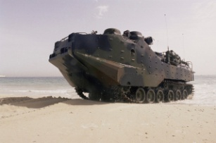



powers not delegated to the United States by the Constitution…are reserved to the States
This highlights the principle of “Federalism”
  This means that some powers belong to the National/Federal Government
  And some powers belong to the state governments
Provide protection (police)
Provide education
Coin money
Declare war
Issue drivers’ licenses
Issue marriage licenses
Make treaties
Form an army

Slide 40
Last 5 Amendments in the Bill of Rights
Amendment VI: Right to a jury trial and the right to counsel (an attorney)
Amendment VII: Right to trial by jury in cases with value exceeding $20
Amendment VIII: Freedom from excessive bail and cruel and unusual punishment
RECAP!
Amendment IX: Rights not listed in the Constitution are not to be denied or abused
Amendment X: Those powers not given or prohibited to the national government are reserved for the states.

Slide 41


Next 5 Amendments in the Bill of Rights
Amendment VI: Right to a jury trial and the right to counsel (an attorney)
Amendment VII: Right to trial by jury in cases with value exceeding $20
Amendment VIII: Freedom from excessive bail and cruel and unusual punishment
RECAP!
Amendment IX: Rights not listed in the Constitution are not to be denied or abused
Amendment X: Those powers not given or prohibited to the national government are reserved for the states.

Slide 42

Review Time!
Read through the 10 amendments we have discussed from the Bill of Rights.
Individually, summarize each of the rights in your own words.
Get into a group of 3-5
Share your summaries of the rights in the Bill of Rights!

Slide 43
First 5 Amendments in the Bill of Rights
Amendment I: Freedom of religion, speech, assembly, press, and to petition the government
Amendment II: Right to bear arms
Amendment III: No quartering of solider in time of peace
Amendment IV: Freedom from unreasonable searches or seizures (without a warrant or probable cause)
Amendment V: Freedom from double jeopardy, from self-incrimination, right to due process, and eminent domain

Slide 44
Next 5 Amendments in the Bill of Rights
Amendment VI: Right to a jury trial and the right to counsel (an attorney)
Amendment VII: Right to trial by jury in cases with value exceeding $20
Amendment VIII: Freedom from excessive bail and cruel and unusual punishment
Amendment IX: Rights not listed in the Constitution are not to be denied or abused
Amendment X: Those powers not given or prohibited to the national government are reserved for the states.

Slide 45
Rights Re-Write…
You are about to travel back in time to the writing of the Bill of Rights. The Framers have decided that 10 amendments are too many – they only wish to keep 5.
Individually, decide which five rights you want to keep. Put a ✓ next to the five rights you find to be the most important.
Now, in your group, you must select five rights to keep as a group. You will need to work together and compromise on the five 5 you select.

Slide 46
As a class…
What are the five rights you found to be the most important?
What rights were not included?
What are the consequences if those rights are not included?

